Slide 1
Chapter 2 The OSI Model and TCP/IP Protocol Suite

Slide 2
Outline
PROTOCOL LAYERS
THE OSI MODEL
TCP/IP PROTOCOL SUITE
ADDRESSING

Slide 3
2.1
PROTOCOL LAYERS
The McGraw-Hill Companies, Inc., 2000

Slide 4
Protocols
A protocol is needed when two entities need to communicate
When communication is not simple
Divide the complex task of communication into several layers

Slide 5
Example 2.1: Communication Using Only One Layer
Assume
Maria speaks only Spanish
Ann speaks only English
But they both learned the sign language (手語）
Thus, they can communicate by sign language

Slide 6
Example 2.2: Communication Using Three Layers
Assume
Ann moves to another town
Two machines:
1st machine: scan and transform a letter in English to a secret code and vice versa
2nd machine: scan and transform a letter in Spanish to a secret code and vice versa
Communication now needs three layers
3rd layer: Maria (Ann) writes a letter in Spanish (English)
2nd layer: Use the machine to generate the secret code
1st layer : sent by the post office

Slide 7
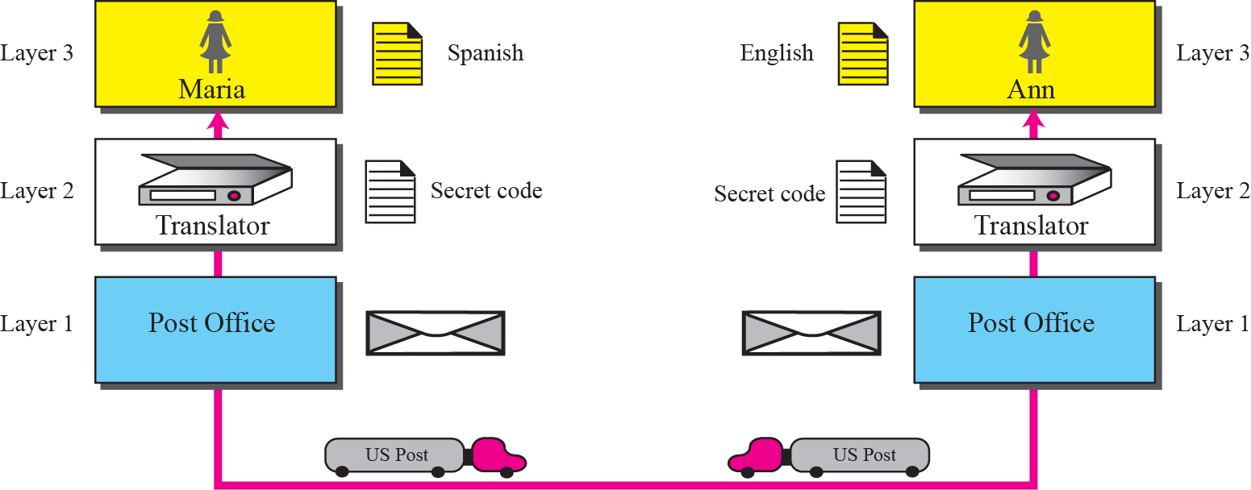
Example 2: Communication Using Three Layers (Cont.)

Slide 8
2.2
THE
OSI
MODEL
The McGraw-Hill Companies, Inc., 2000

Slide 9
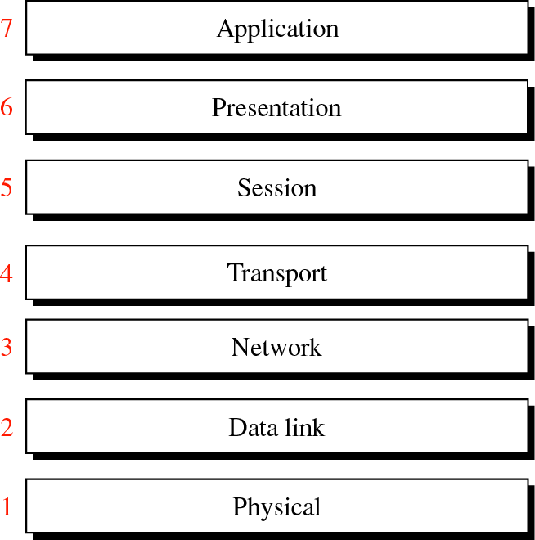
Figure 2-1
OSI Model
The McGraw-Hill Companies, Inc., 2000

Slide 10
Layered Architecture
Within a single machine
Each layer calls upon the services of the layer just below it
For example, layer 3 uses the services provided by layer 2 and provides services for layer 4

Slide 11
Layered Architecture (Cont.)
Between machines
Layer x on one machine communicates with layer x on another machine
This communication is governed by a series of rules and conventions called protocols

Slide 12
Layered Architecture (Cont.)
As the message travels from A to B, it may pass through intermediate nodes
These intermediate nodes usually involve only the first three layers of the OSI model
As shown in the next slide

Slide 13

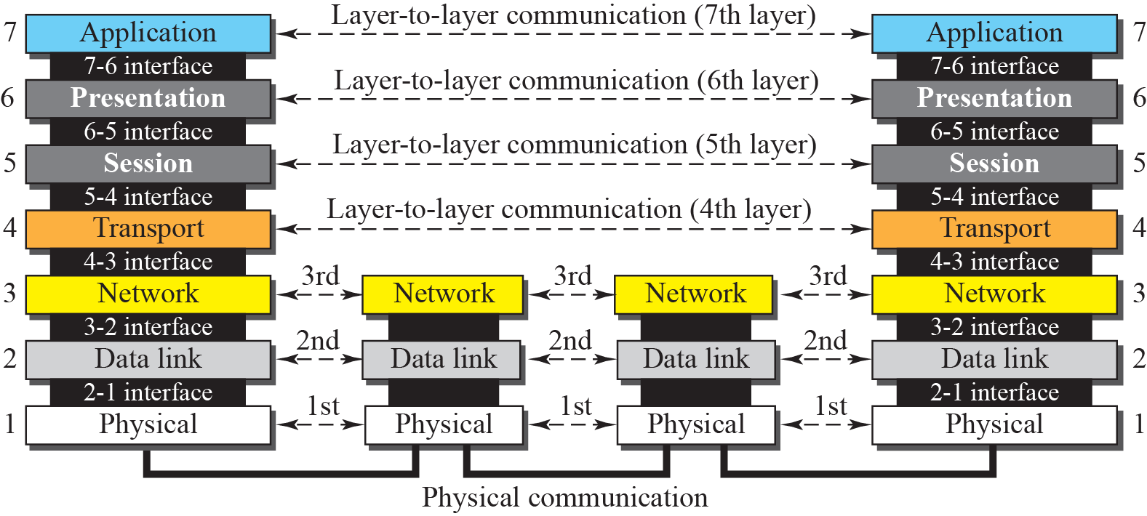
Figure 2-2
OSI Layers
The McGraw-Hill Companies, Inc., 2000

Slide 14
Layer-to-Layer Communication
Each layer in the sending device added its own information to the message
At the receiving machine, the message is unwrapped layer by layer

Slide 15

Headers are added to the data at layers 6, 5, 4, 3, and 2. Trailers are usually added only at layer 2.
The McGraw-Hill Companies, Inc., 2000

Slide 16
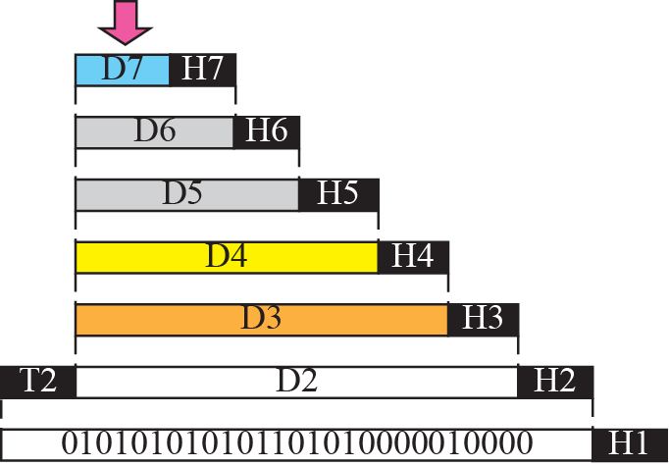


Figure 2-3
An Exchange Using the OSI Model
The McGraw-Hill Companies, Inc., 2000

Slide 17
2.3
LAYERS IN
THE OSI MODEL
The McGraw-Hill Companies, Inc., 2000

Slide 18
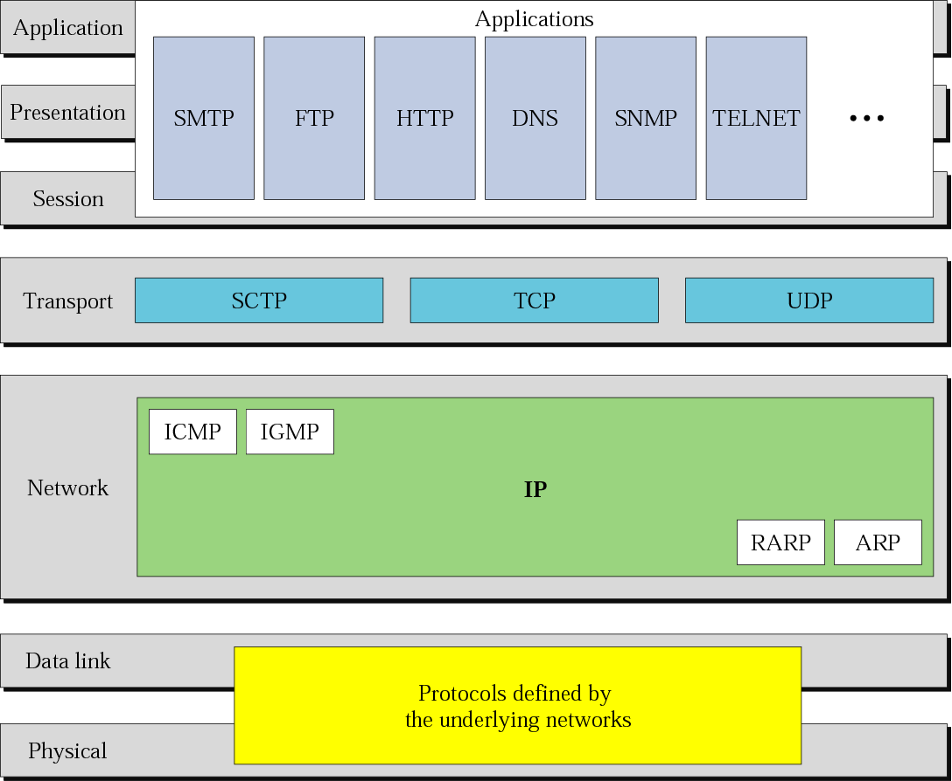
Figure 2-15
TCP/IP and OSI Model
The McGraw-Hill Companies, Inc., 2000

Slide 19
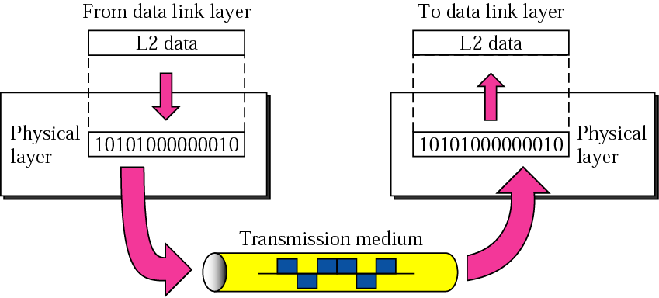
Figure 2-4
Physical Layer
The McGraw-Hill Companies, Inc., 2000

Slide 20

Note
The physical layer is responsible for moving individual bits from one
Node to the next.

Slide 21
Physical Layer
Physical characteristics of interface and media
Interface between the devices and transmission media
The type of transmission media
Representation of bits
Define the type of encoding (how 0s and 1s are changed to signals)

Slide 22
Physical Layer (Cont.)
Data rate
The number of bits sent each second
Synchronization of bits
The sender and receiver must not only use the same bit rate but must also be synchronized at the bit level

Slide 23
Physical Layer (Cont.)
Line configuration
Be concerned with the connection of devices to the media
Point-to-point configuration
Two devices are connected through a dedicated link
Multipoint configuration
A link is shared between several devices
Physical topology
Define how devices are connected to make a network
For example, mesh, star, ring, or bus topology

Slide 24
Physical Layer (Cont.)
Transmission mode
Define the direction of transmission between two devices
Simple mode
only one device can send
Half-duplex mode
two devices can send and receive but not at the same time
Full-duplex mode
Two devices can send and receive at the same time

Slide 25
Data Link Layer
Transform the physical layer to a reliable link
Make the physical layer appear error free to the upper layer

Slide 26
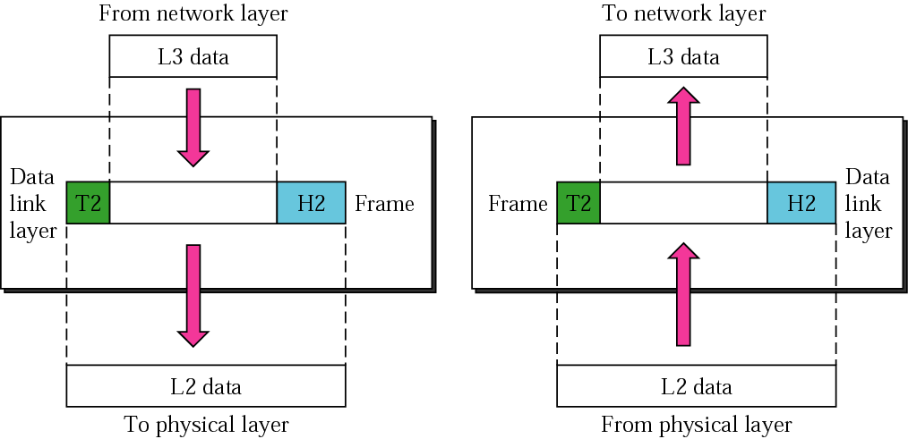
Figure 2-5
Data Link Layer
The McGraw-Hill Companies, Inc., 2000

Slide 27
Data Link Layer
Framing
Divide the stream of bits into frames
Physical addressing
only one hop
Flow control
Error control
Detect and retransmit damaged or lost frames
Prevent duplication of frames

Slide 28
Data Link Layer (Cont.)
Access control
Determine which device has control over the link at any given time

Slide 29
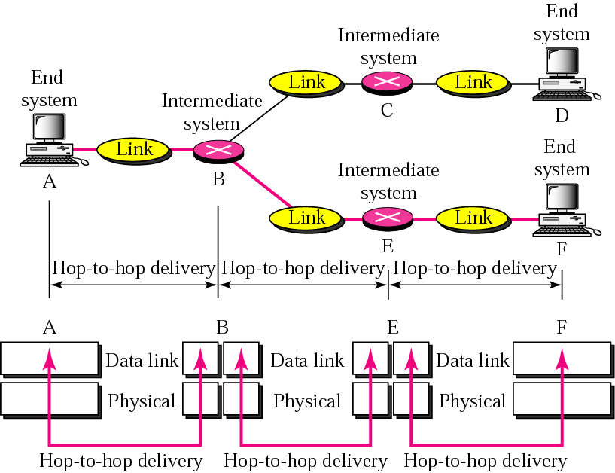
Figure 2-6
Node-to-Node (Hop-to-Hop) Delivery
The McGraw-Hill Companies, Inc., 2000

Slide 30
Network Layer
Be responsible for the source-to-destination delivery of a packet possibly across multiple networks
Data link layer take care of the delivery of the packet between two systems on the same network
Network layer ensures the delivery of a packet from source to destination

Slide 31
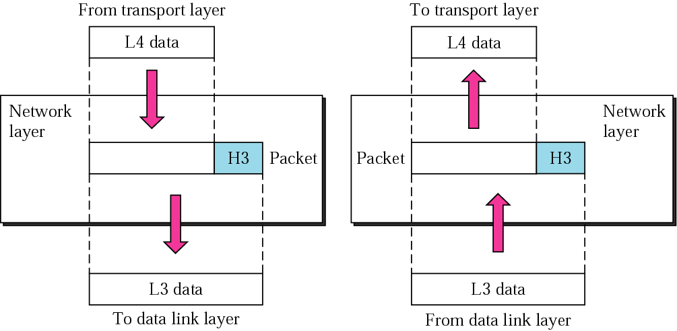
Figure 2-7
Network Layer
The McGraw-Hill Companies, Inc., 2000

Slide 32
Network Layer
Logical addressing
Physical addressing in the data link layer handles the addressing problem locally
If a packet pass the network boundary
We need another addressing system
Routing

Slide 33
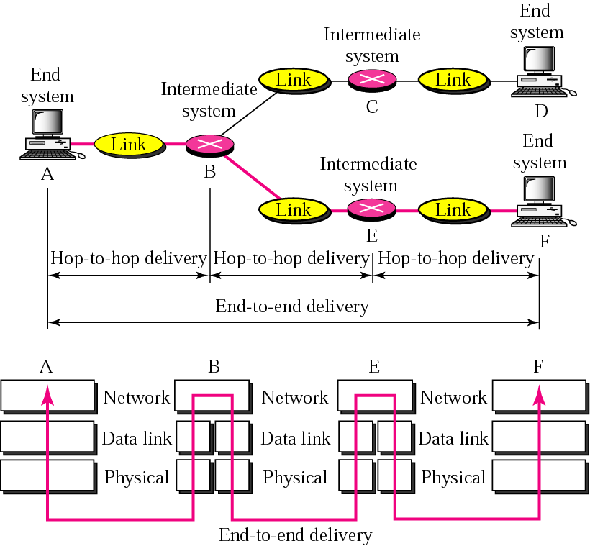
Figure 2-8
End-to-End Delivery by the Network Layer
The McGraw-Hill Companies, Inc., 2000

Slide 34
Transport Layer
Be responsible for source-to-destination (end-to-end) delivery of the entire message
Network layer only oversees the end-to-end delivery of individual packets
Oversee both error control and flow control at the source-to-destination level

Slide 35
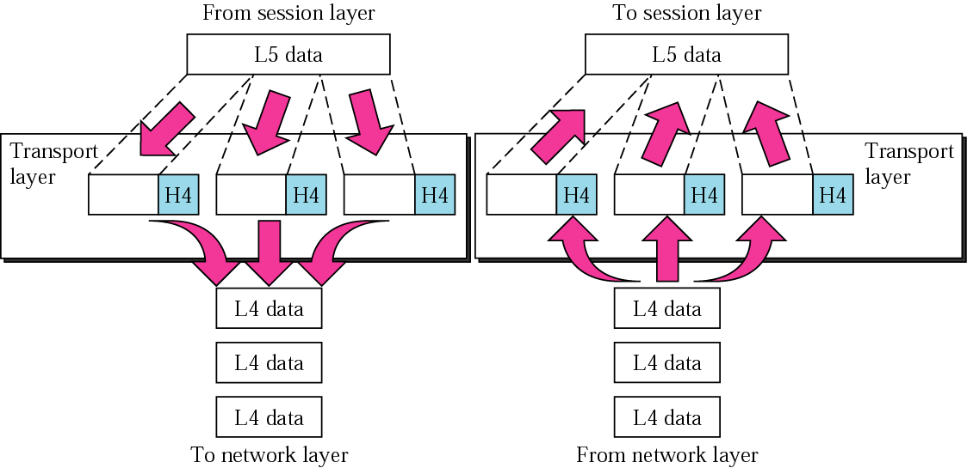
Figure 2-9
Transport Layer
The McGraw-Hill Companies, Inc., 2000

Slide 36
Transport Layer
Service-point addressing
Service-point address: port address
The network layer gets each packet to the correct computer
The transport layer gets the entire message to the correct process on that computer
Segmentation and reassembly

Slide 37
Transport Layer (Cont.)
Connection control
Connectionless
Connection-oriented
Flow control
End to end flow control
The flow control, however, at the data link layer is across a single link

Slide 38
Transport Layer (Cont.)
Error control
End to end error control that makes sure that the entire message arrives without error (damage, loss, or duplication)
Error correction is usually achieved through retransmission
The error control, however, at the data link layer is across a single link and applies to a single frame

Slide 39
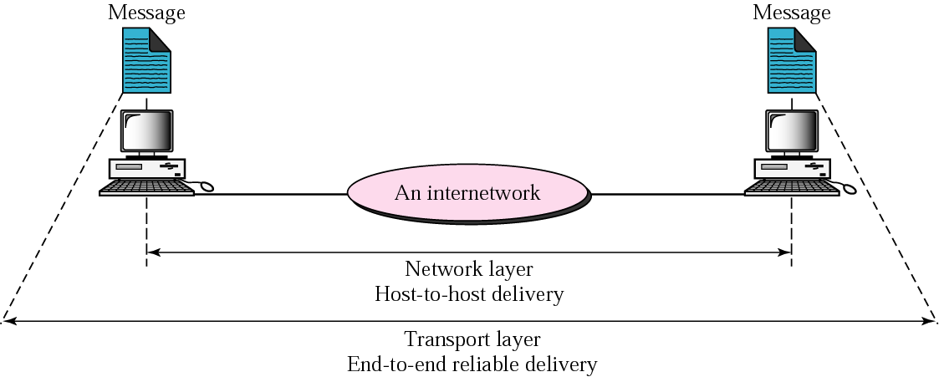
Figure 2-10
Reliable End-to-End Delivery of a Message
end-to-end delivery by the transport layer
The McGraw-Hill Companies, Inc., 2000

Slide 40
Session Layer
Session layer is the network dialog controller
It establishes, maintains, and synchronizes the interaction between communication systems

Slide 41
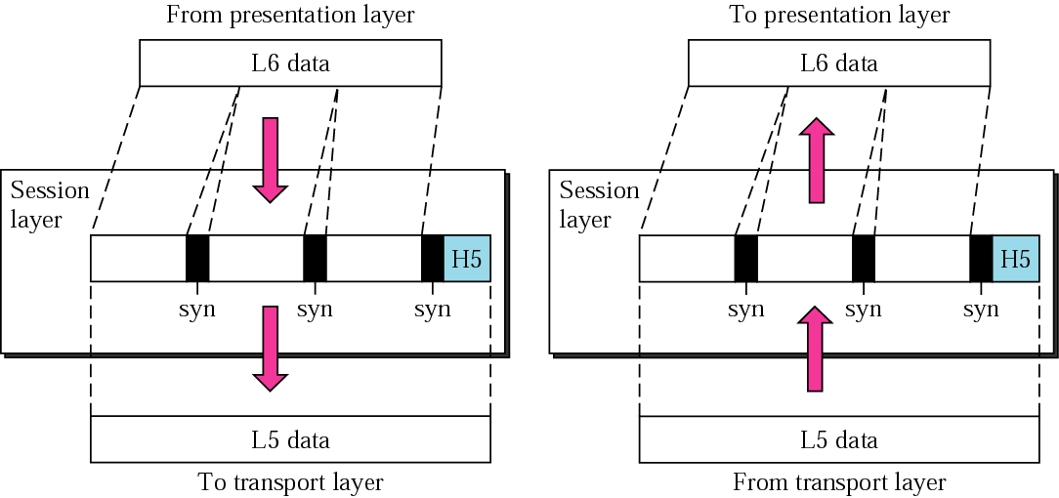
Figure 2-11
Session Layer
The McGraw-Hill Companies, Inc., 2000

Slide 42
Session Layer
Dialog control
Allow two systems to enter a dialog
Allow the communication between two processes in
Half-duplex
Full-duplex
Synchronization
Allow a process to add checkpoints (synchronization points) into a stream of data

Slide 43
Presentation Layer
Be concerned with the syntax and semantics of the information exchanged between two systems

Slide 44
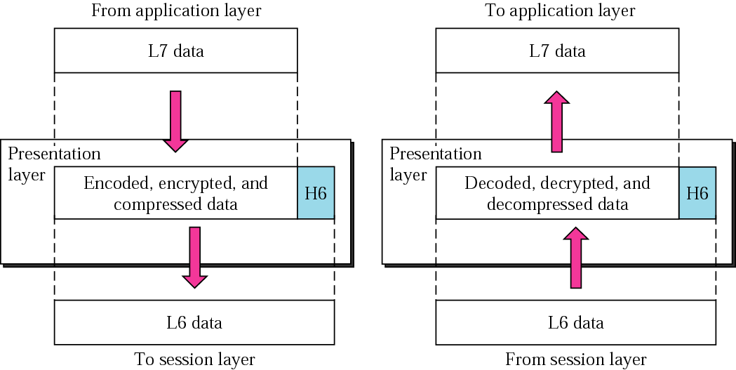
Figure 2-12
Presentation Layer
The McGraw-Hill Companies, Inc., 2000

Slide 45
Presentation Layer
Translation
Different computers use different encoding systems
The presentation layer is responsible for interoperability between these different encoding methods
Encryption
Compression

Slide 46
Application Layer
The application layer enables the user, whether human or software, to access the network

Slide 47
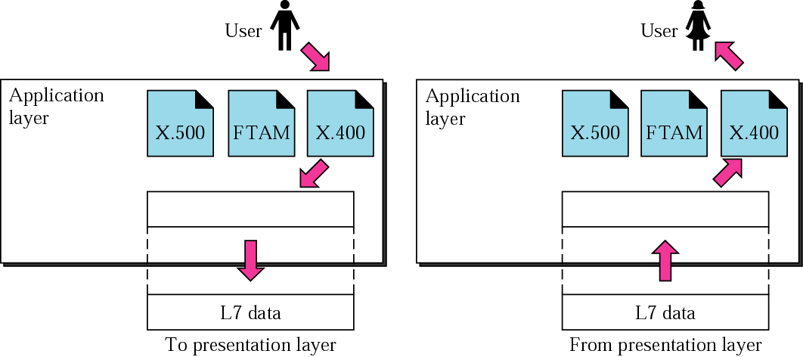
Figure 2-13
Application Layer
The McGraw-Hill Companies, Inc., 2000

Slide 48
Application Layer
Specific services provided by the application layer
Network virtual terminal
File transfer, access, and management (FTAM)
Mail services
Directory services

Slide 49
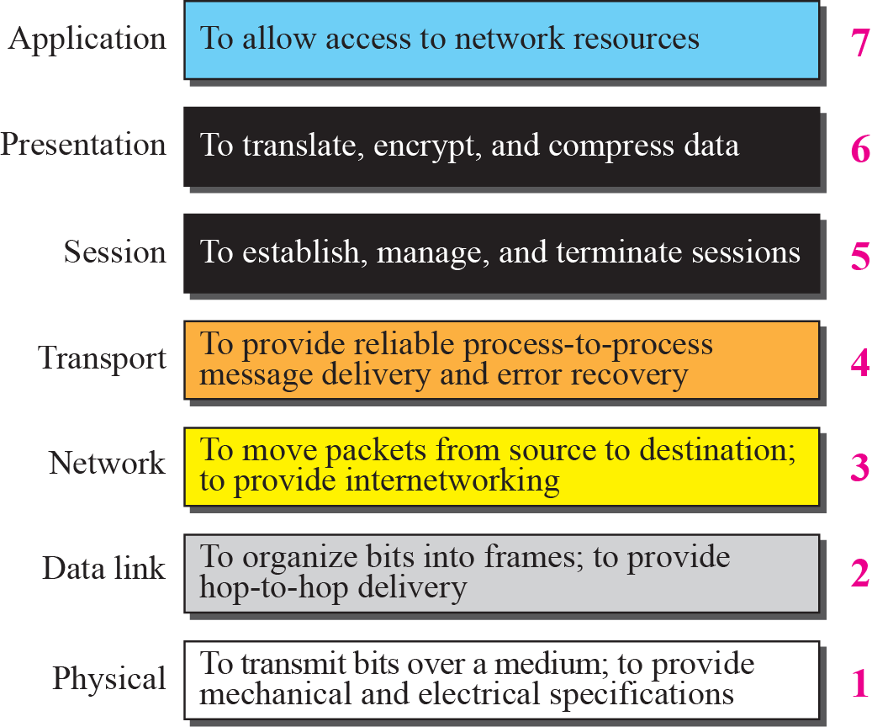
Figure 2-14
Summary of Layers
The McGraw-Hill Companies, Inc., 2000

Slide 50
2.3
TCP/IP
PROTOCOL
SUITE

Slide 51
TCP/IP Protocol Suite
TCP/IP protocol suite was developed prior to the OSI model
The original TCP/IP protocol suite was defined as four software layers built upon the hardware
Today, TCP/IP is thought of as a five-layer model
Physical, data link, network, transport, and application

Slide 52
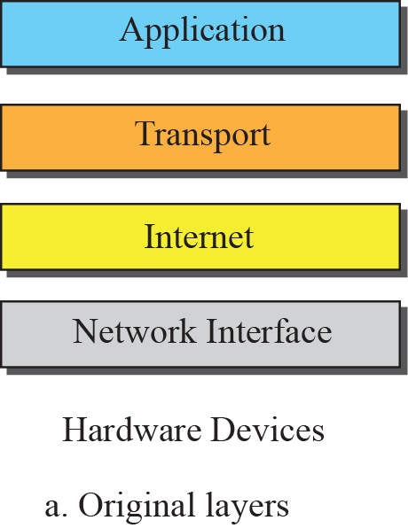
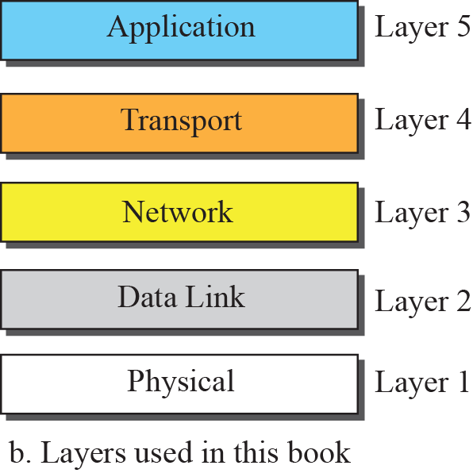

Layers in the TCP/IP Protocol Suite

Slide 53
Comparison between OSI and TCP/IP Protocol Suite
Session and presentation layers are missing
The application layer in the suite is considered to be the combination of three layers in the OSI model

Slide 54
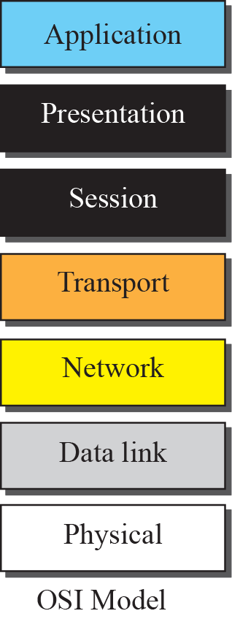
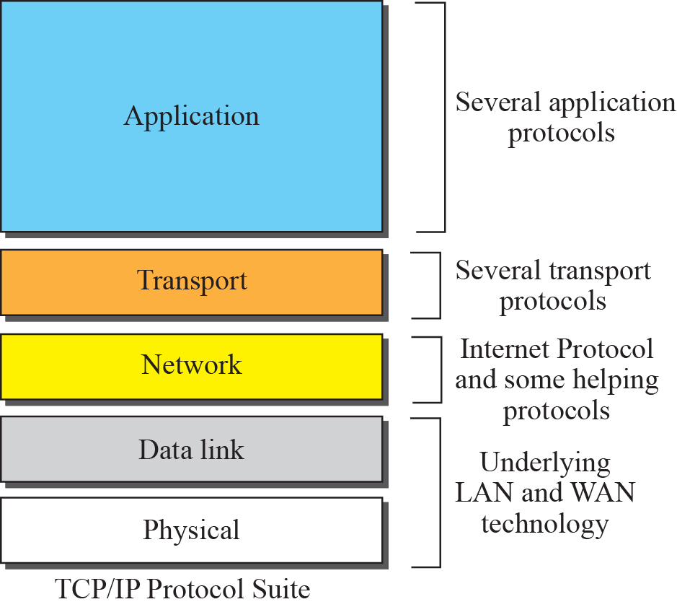
TCP/IP and OSI Model

Slide 55
Figure 2-15
TCP/IP and OSI Model
The McGraw-Hill Companies, Inc., 2000

Slide 56
Layers in the TCP/IP Protocol Suite
Definition: Link
A network that allows a set of computers to communicate with each other
A link can be a LAN (Local Area Network) or a WAN (Wide Area Network)
Different links connected by devices called routers or switches

Slide 57
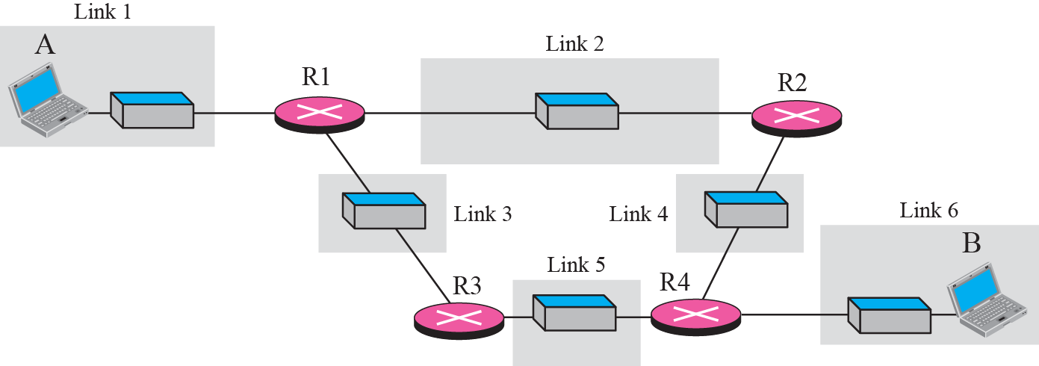
An internet
Six links and four routers

Slide 58
Physical Layers
TCP/IP does not define any specific protocol
TCP/IP supports all of the standard and proprietary protocols
The communication is between two hops or nodes
The unit of communication is a single bit
If a node is connected to n links, it needs n physical-layer protocol, one for each link
Since different link may use different physical-layer protocols

Slide 59
Data Link Layers
TCP/IP does not define any specific protocol
TCP/IP supports all of the standard and proprietary protocols
The unit of communication is a packet called a frame
The communication is between two hops or nodes

Slide 60
Network Layer
Internetworking Protocols (IP)
IP transport data in packets called datagrams
The communication is end-to-end
The communication in layer 1 and layer 2 is node-to-node

Slide 61
Network Layer (Cont.)
Four supporting protocols
ARP
RARP
ICMP
IGMP

Slide 62
Transport Layer
Main difference between transport layer and network layer
All nodes in a network need to have the network layer
Only the two end computers need to have the transport layer
Deliver the whole message, which is called a segment, a user datagram, or a packet, from A to B
A segment may consists of a few or tens of datagrams

Slide 63
Summary
A packet in the data link layer is called a frame.
A packet in the network layer is called a datagram.
A packet in the transport layer is called a user datagram, segment, or packet.

Slide 64
Transport Layer (Cont.)
Three transport layer protocols
UDP (User Datagram Protocol)
TCP (Transmission Control Protocol)
SCTP (Stream Control Transmission Protocol)

Slide 65
Comparison
Transport Layer
A process-to-process protocol
Network Layer
A host-to-host protocol
Layer 1 and Layer 2
A node-to-node protocol

Slide 66
Application Layer
The application layer in TCP/IP is equivalent to the combined session, presentation, and application layers in the OSI model
Many protocols are defined in this layer
DHCP,DNS, TELNET, SSH, FTP, TFTP, HTTP, SMTP, POP, IMAP, MIME, SNMP…

Slide 67
2.4
ADDRESSING
The McGraw-Hill Companies, Inc., 2000

Slide 68
Addresses
Four levels of addresses in TCP/IP protocols
Physical address
Logical address
Port address
Application-specific address

Slide 69
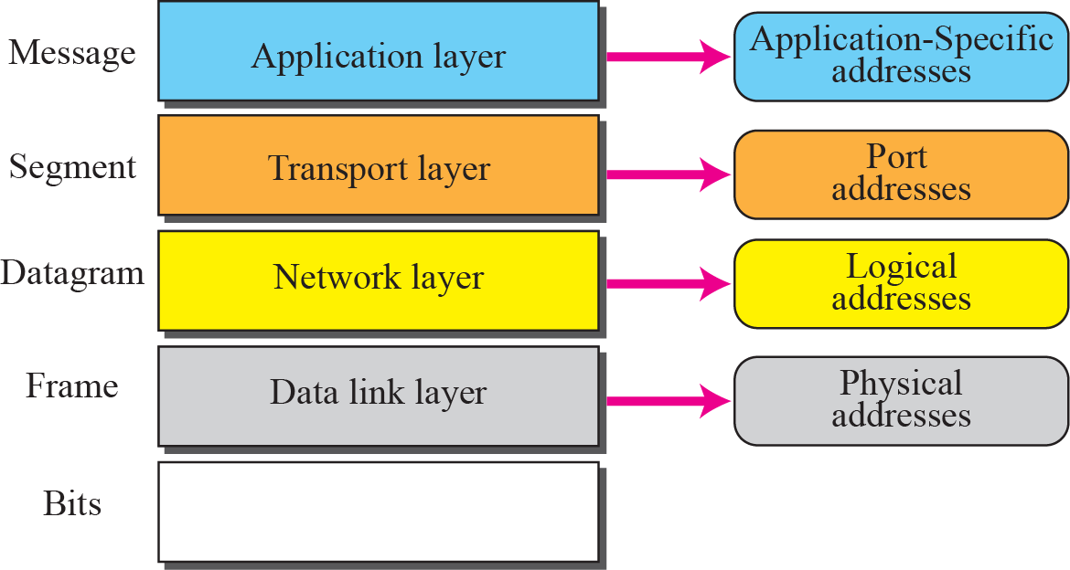
Figure 2-17
Relationship of Layers and Addresses in TCP/IP
The McGraw-Hill Companies, Inc., 2000

Slide 70
Physical Address
Also called link address, the address of a node as defined by its LAN or WAN
Ethernet: 6 byte imprinted on NIC (Network Interface Card)
LocalTalk: 1 byte dynamic address
Physical address can be either
Unicast address
Multicast address
Broadcast address

Slide 71
Example 2.3
Next Figure shows an example of physical addresses.
The McGraw-Hill Companies, Inc., 2000

Slide 72
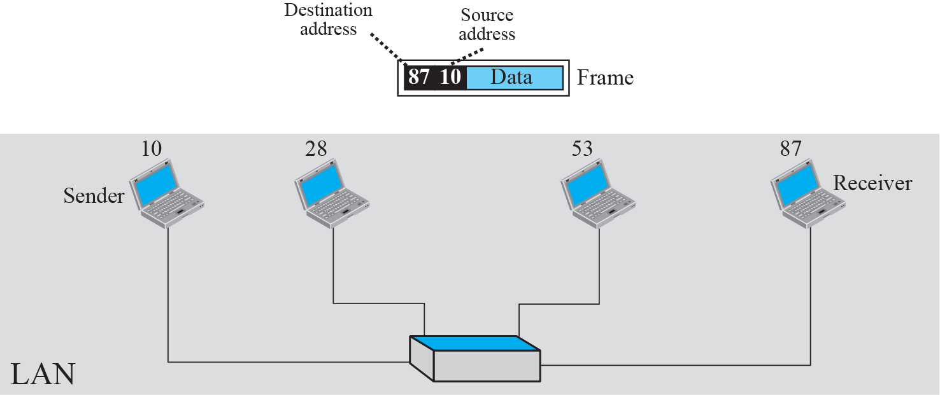
Figure 2-18
Physical Addresses
The McGraw-Hill Companies, Inc., 2000

Slide 73
Example 2.4
Most local area networks use a 48-bit (6 bytes) physical address written as 12 hexadecimal digits, with every 2 digits separated by a hyphen as shown below:
07:01:02:01:2C:4B
A 6-byte (12 hexadecimal digits) physical address
The McGraw-Hill Companies, Inc., 2000

Slide 74
Logical Address
Provide universal communication services
Different networks can have different physical address format
A universal addressing system is thus needed
Internet address can also be either in unicast, multicast and broadcast
4 bytes long in IPv4

Slide 75
Example 2.5
Next slide shows an example of Internet addresses.
Network address A and physical address 10 => send data to => Network address P and physical address 95
IP address does not change along the trip
However, physical address changes from network to network (or from hop to hop)
The McGraw-Hill Companies, Inc., 2000

Slide 76
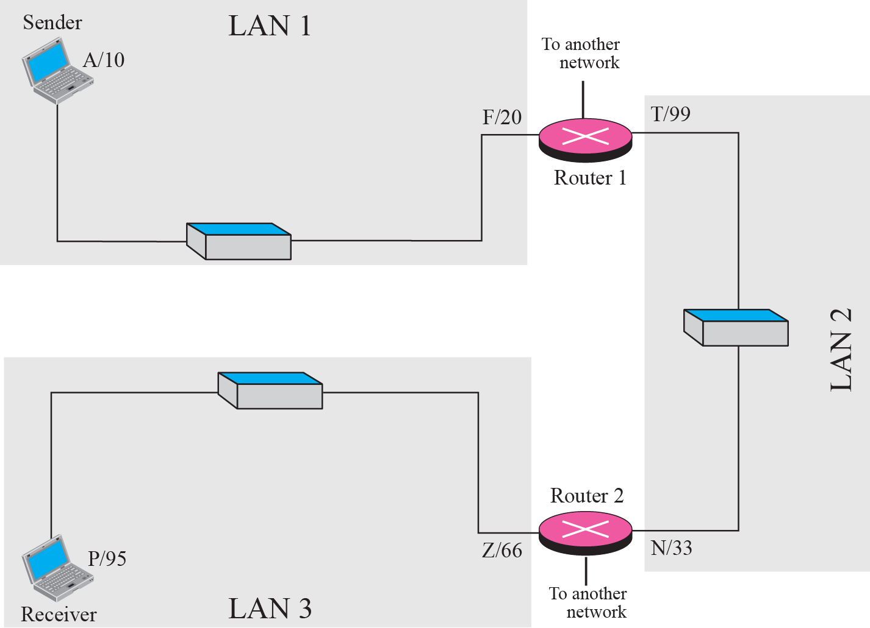

Slide 77
Note
The physical addresses will change from hop to hop, but the logical addresses remain the same.

Slide 78
IP Address
Internet address (in IPv4) is 32 bits in length, normally written as four decimal numbers, with each number representing 1 byte. The numbers are separated by a dot. Below is an example of such an address.
132.24.75.9
The McGraw-Hill Companies, Inc., 2000

Slide 79
Port Address
A label assigns to a process
16 bits long

Slide 80
Example 2.6
Next slide shows an example of transport layer communication
Three processes in the sending computer
Their port numbers are: a, b and c
Two processes in the receiving computer
The port addresses are: j and k
Assume that process with port address a send data to another process with port address j

Slide 81
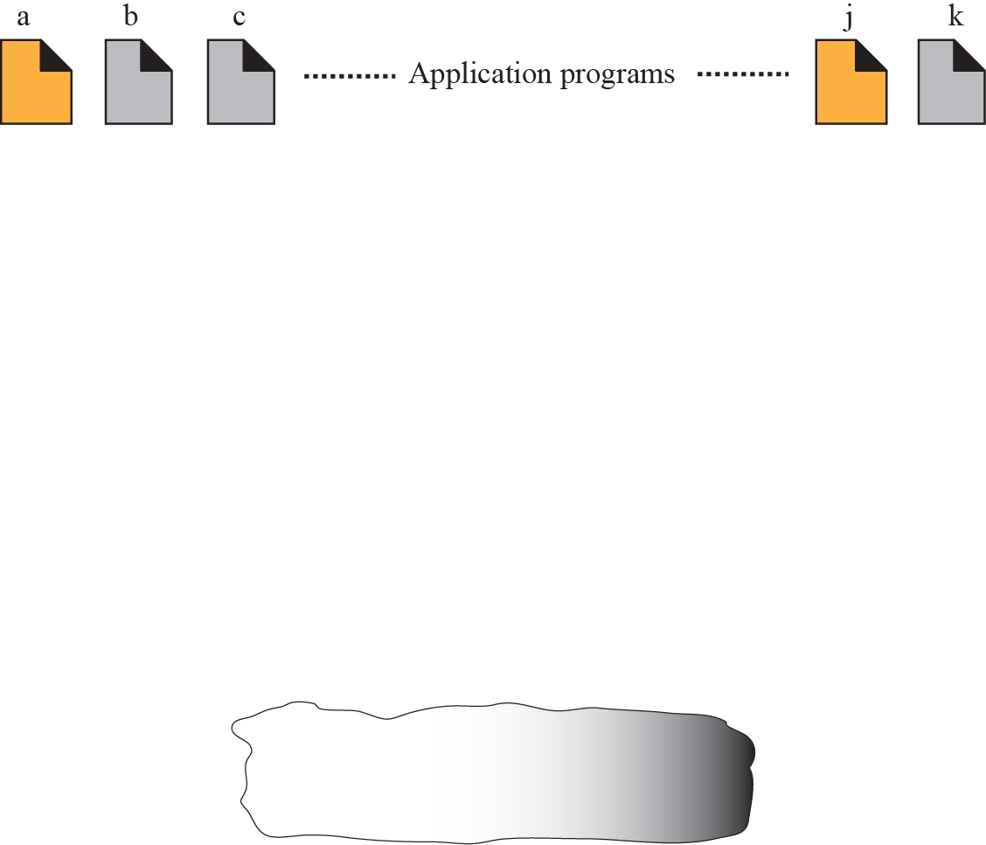
Figure 2-20
Port Numbers
The McGraw-Hill Companies, Inc., 2000

Slide 82
Example 2.7
As we will see in future chapters, a port address is a 16-bit address represented by one decimal number as shown below.
753 A 16-bit port address
The McGraw-Hill Companies, Inc., 2000

Slide 83
Application-Specific Addresses
Some applications have user-friendly addresses
E-mail address: forouzan@fhda.edu
Universal Resource Locator (URL): www.mhhe.com
However, above addresses get changed to the corresponding port and logical addresses by the sending computer

